Slide 1
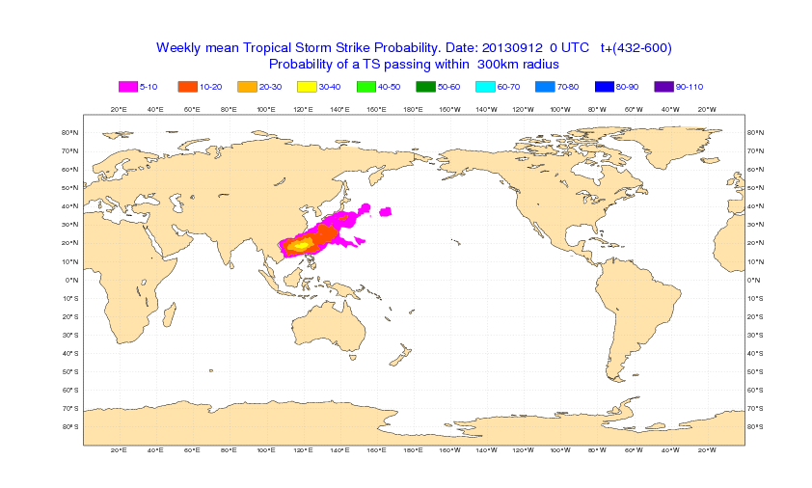
Tropical storm intra-seasonal prediction

Slide 2
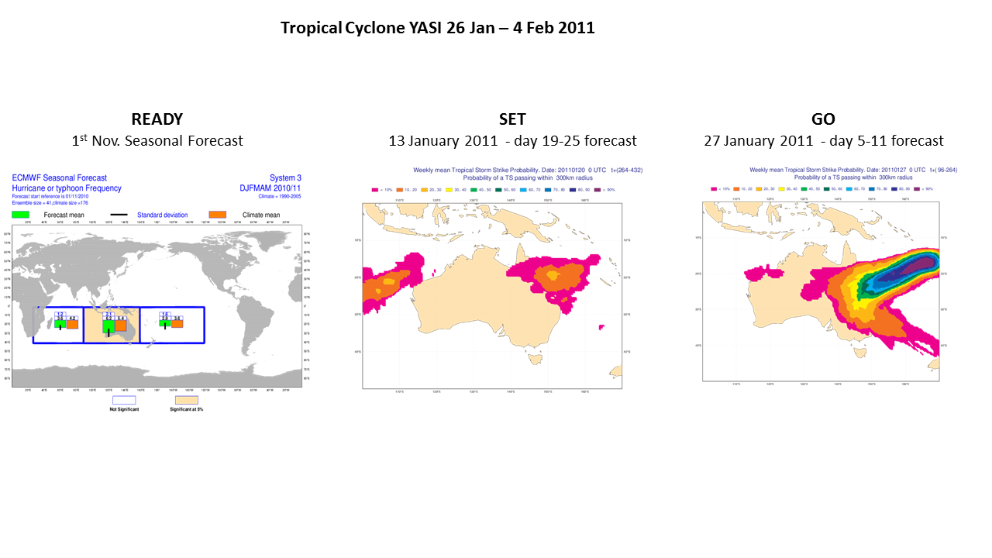

Slide 3
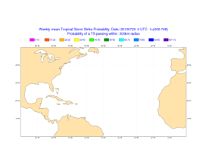
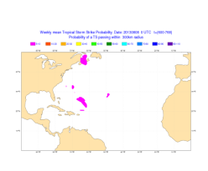

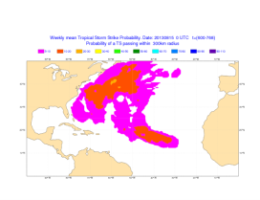
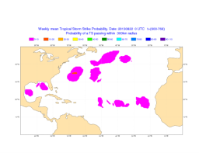
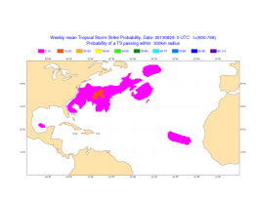
ATL 2013 season – forecast range d26-32
18-25 Aug
26 Aug-1 Sept
2-8 Sept
9-15 Sept
16-23 Sept
23-30 Sept

Slide 4
Tropical Storm Sub-seasonal Prediction
Verification over the Southern Hemisphere as in Leroy et al (2007)
Vitart, Leroy and Wheeler, MWR 2010

Slide 5
TC Forecast Verification – ASO – ROC scores
WEEK 1
WEEK 2
WEEK 3

Slide 6
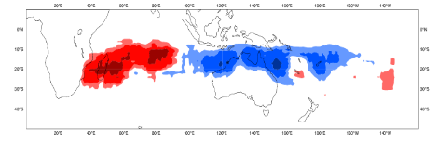
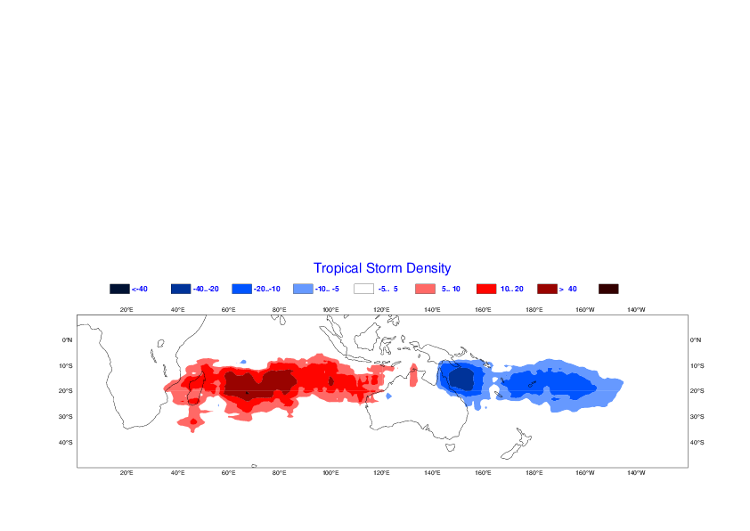
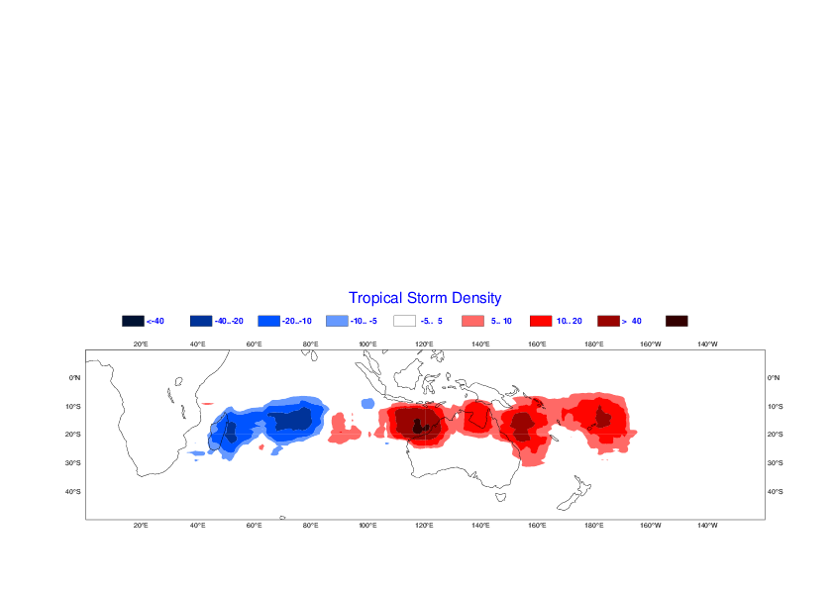
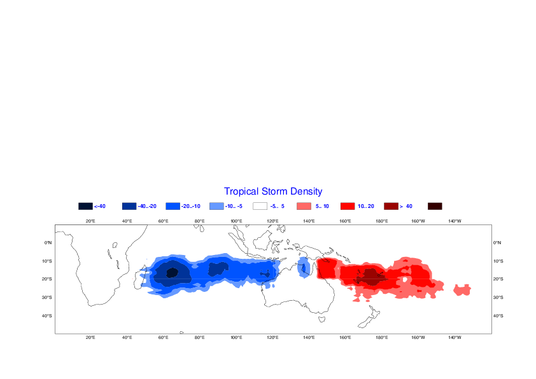
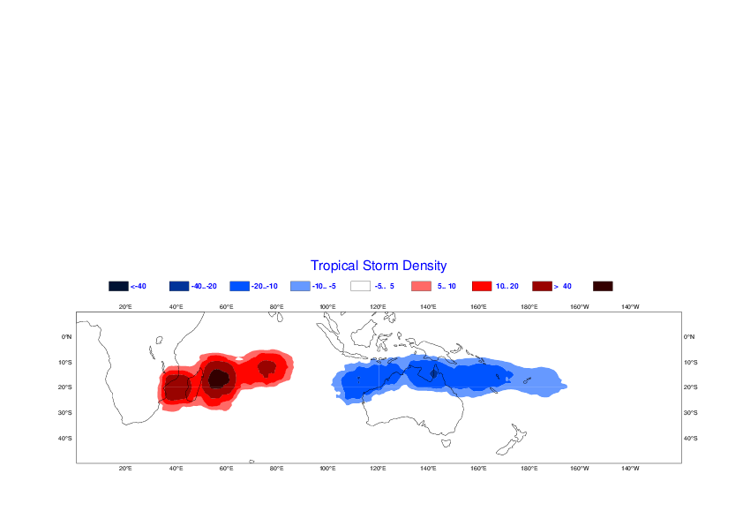
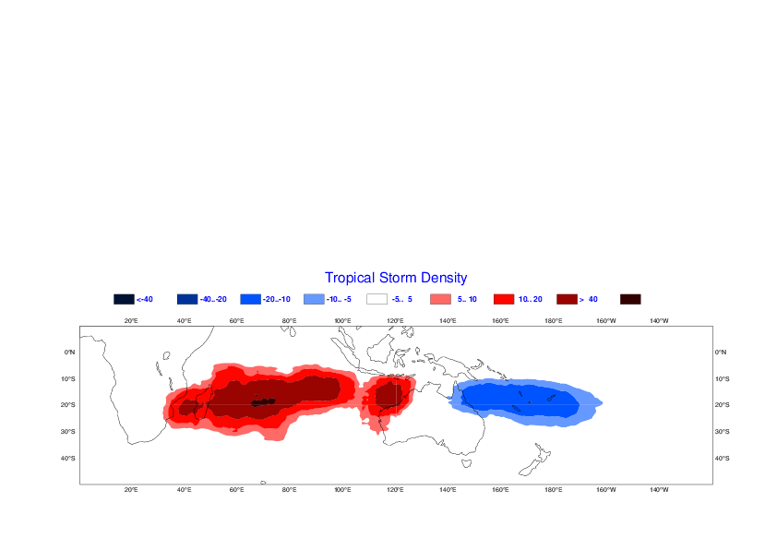
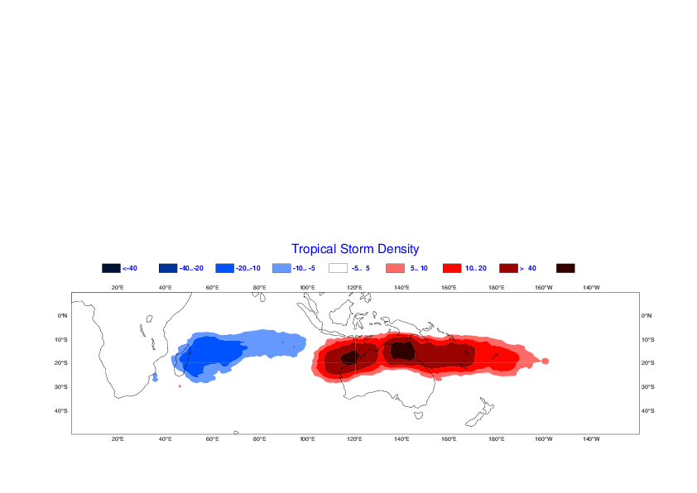
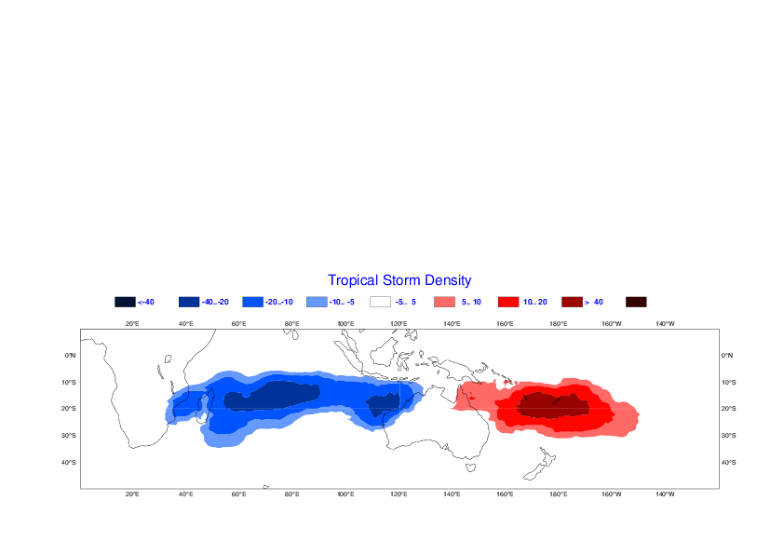
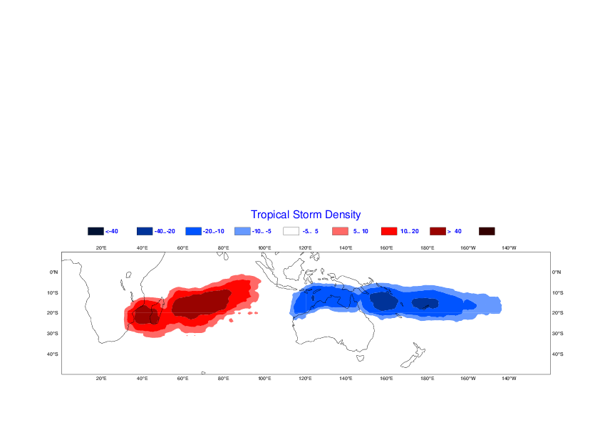
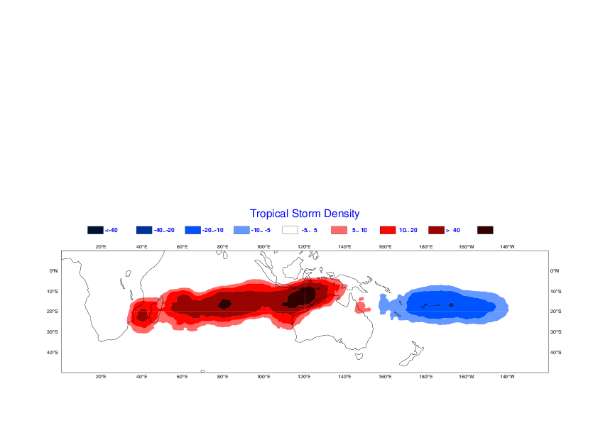
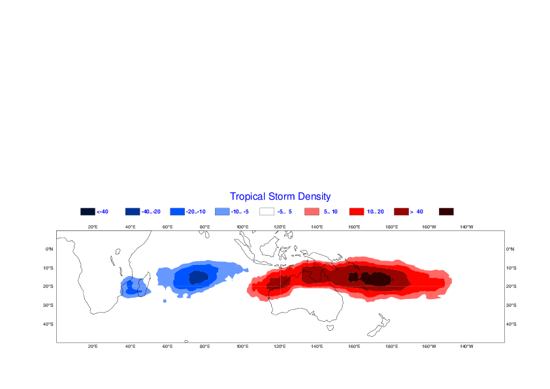
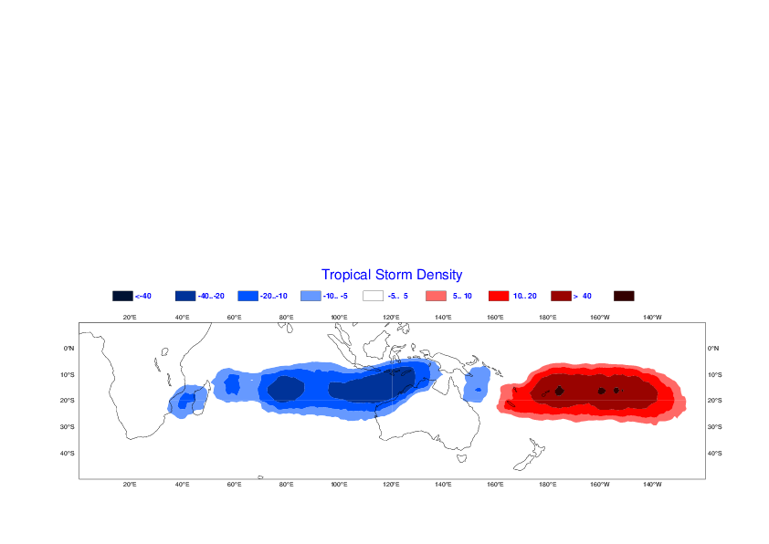
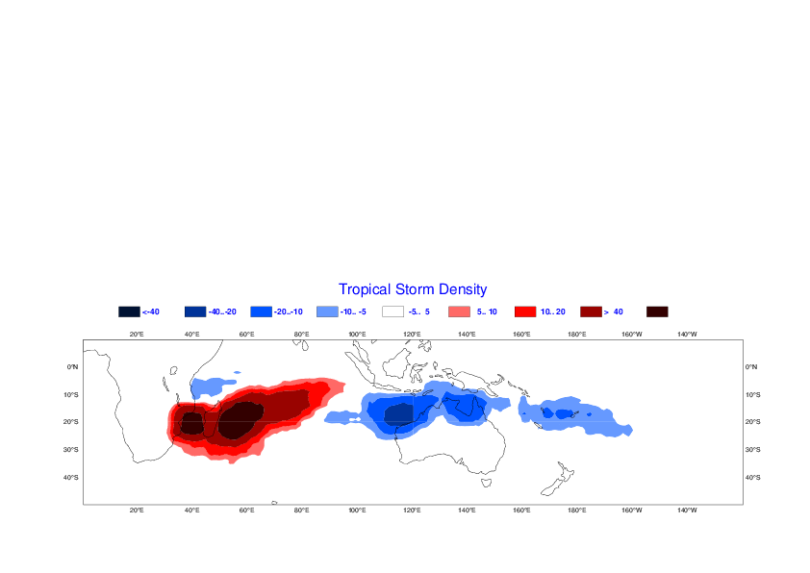
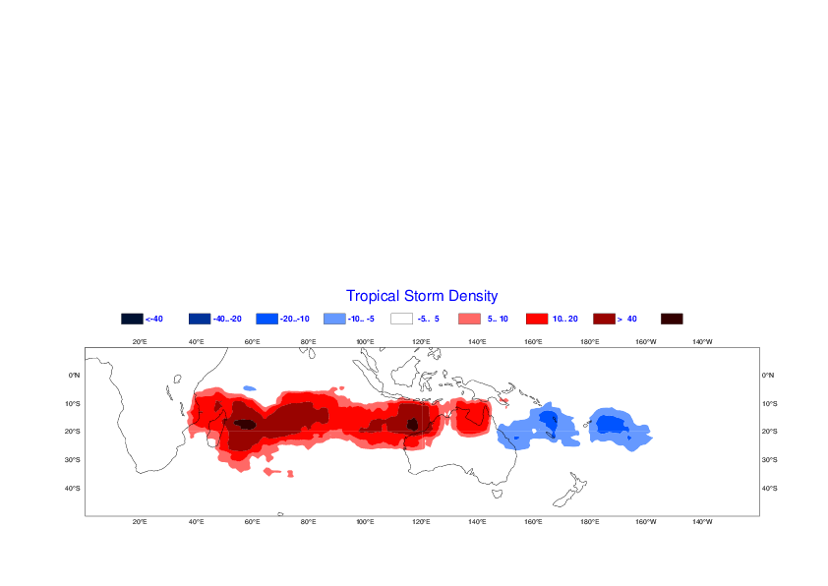
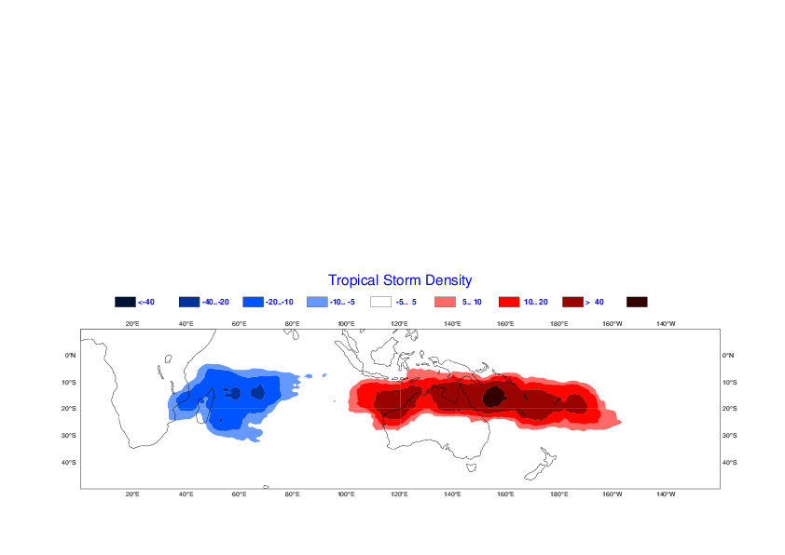
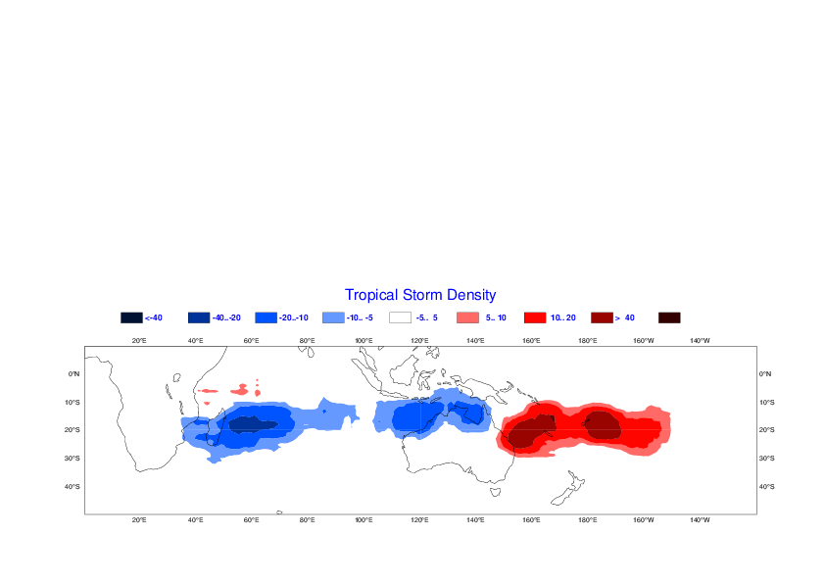
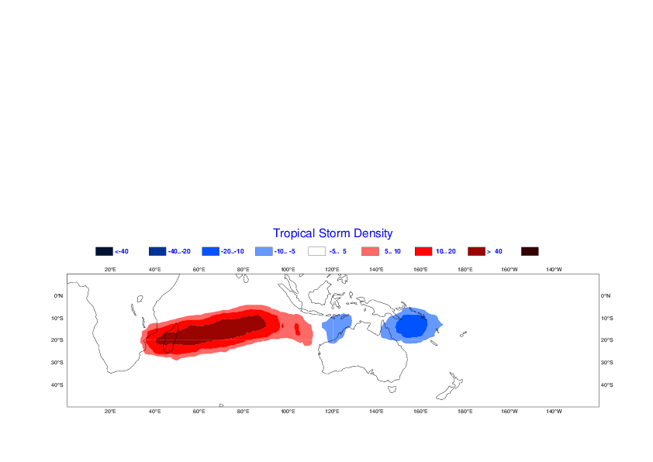
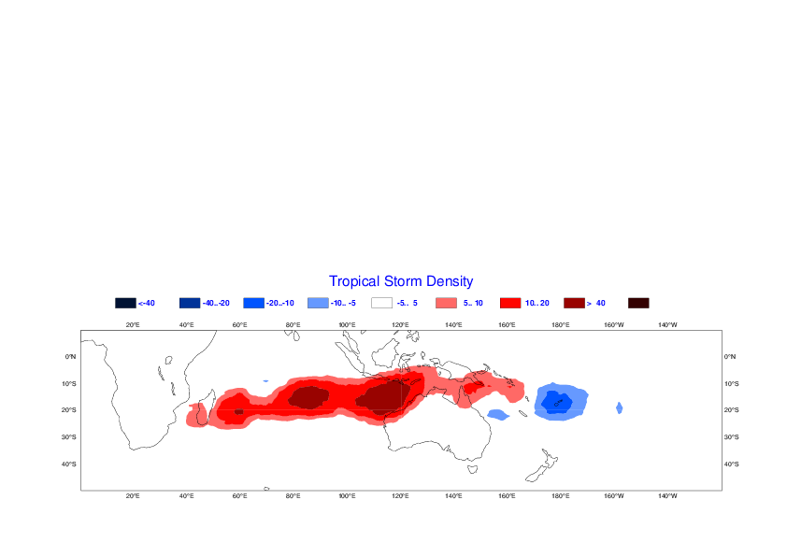
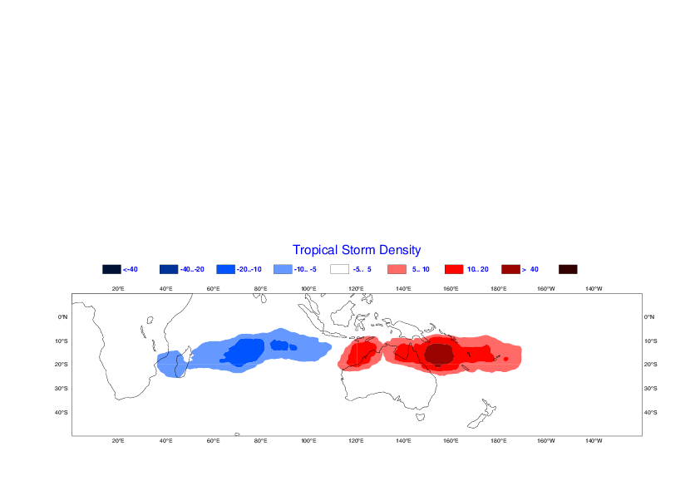
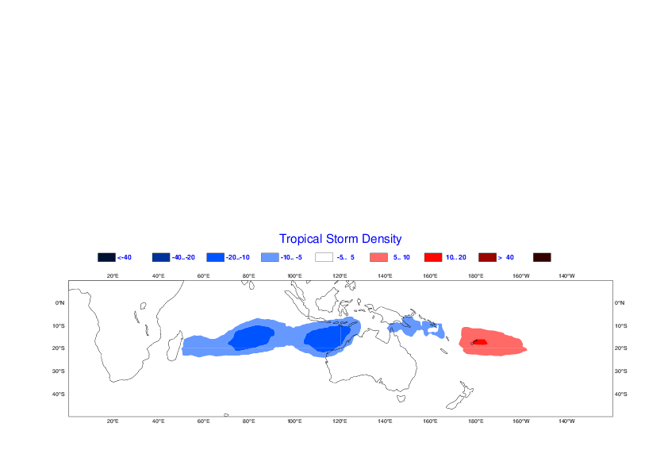
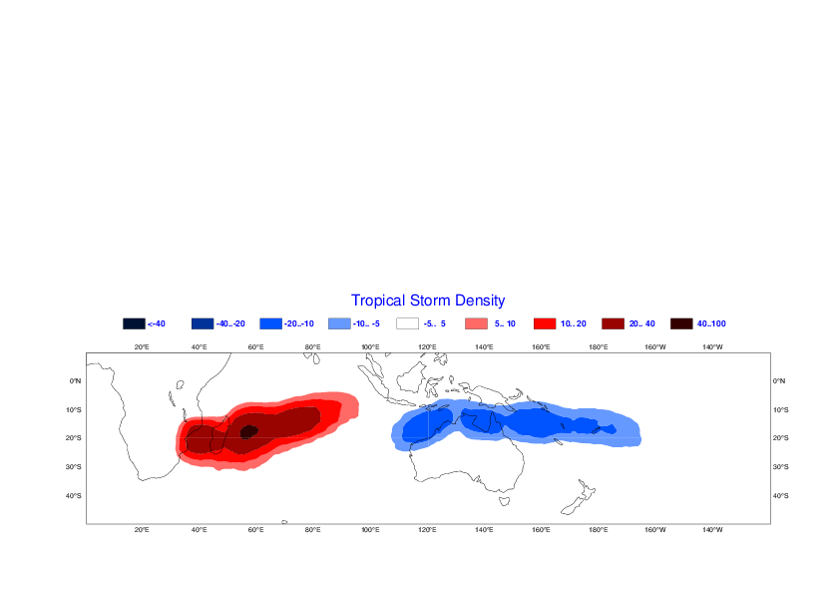
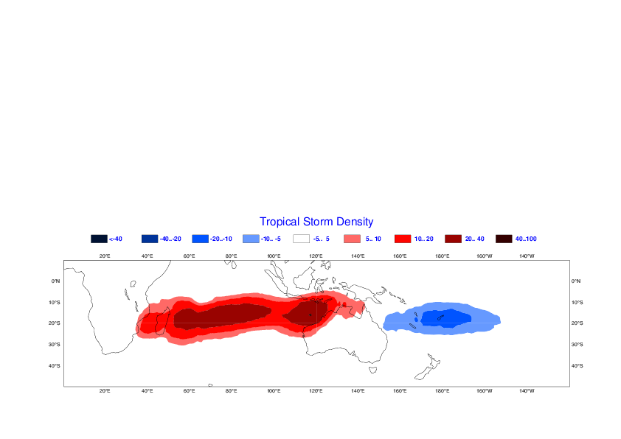
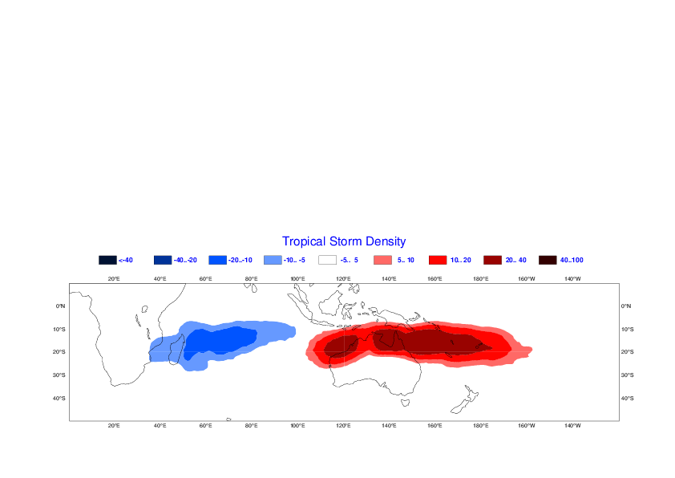
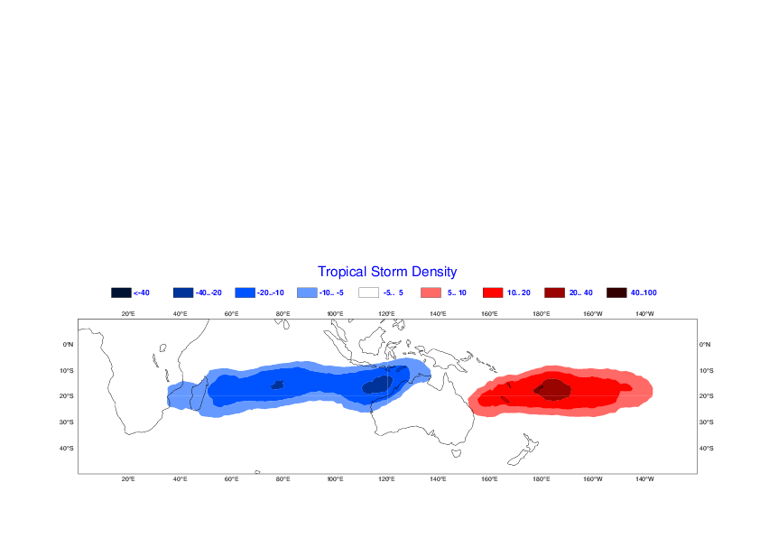

Modulation of tropical cyclone density anomaly by MJO
MJO Phase 2-3
MJO Phase 4-5
MJO Phase 6-7
MJO Phase 8-1
OBS
ECMWF
NCEP
JMA
BoM
Multi
Notes:
Modulation of TC activity by the MJO. The plots show the anomaly of TC density as a function of MJO phase for 5 different S2S models and the multi-model combination for the time range day 10-32. The figure shows a remarkable agreement with observations and suggest that all the model simulate very well the modulation of TCs by the MJO. This is an encouraging result for TC prediction

Slide 7
TC verification
For each grid point (1x1 degree grid):
Compute the Accumulated Cyclone energy (integral of max vel **2) anomalies (relative to past 20 years) for each ensemble member over a 20x10 degree domain and a weekly period
Compute the ACE anomalies from observations (best track data).
Compute Probabilities of ACE anomalies > 0
Compute RPSS score over a domain (e.g. S. Indian ocean). Grid points where ACE observed climatology=0 are excluded.
Advantage of ACE compared to number of Tropical cyclones: More robust measure of TC activities. Number of TCs is a discrete value

Slide 8
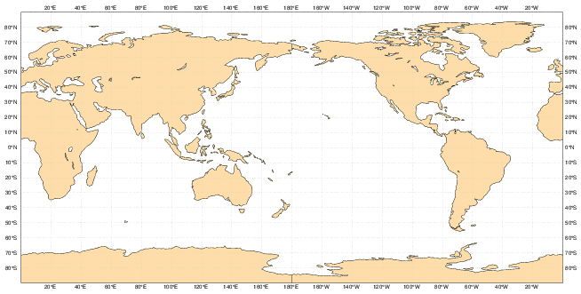
TC Verification

Slide 9
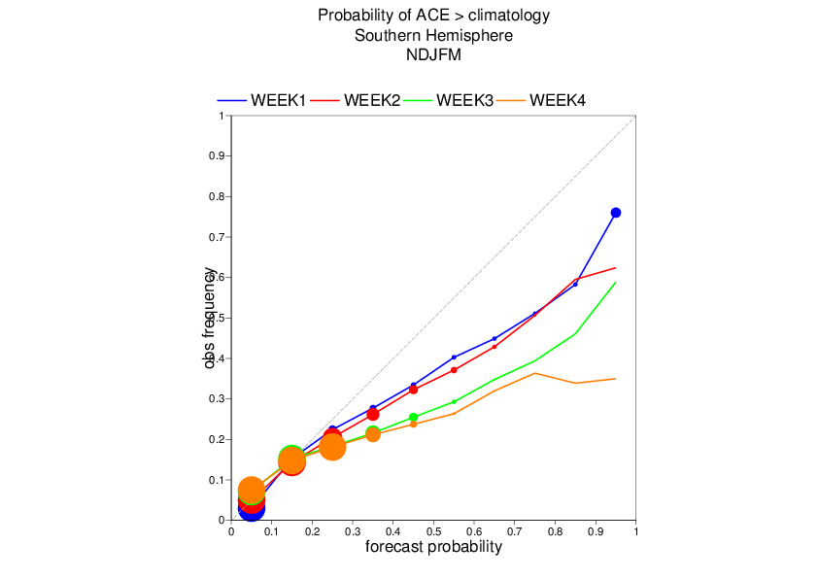
Reliability diagram
Probability of ACE anomaly (20x10 degree box) in upper tercile

Slide 10
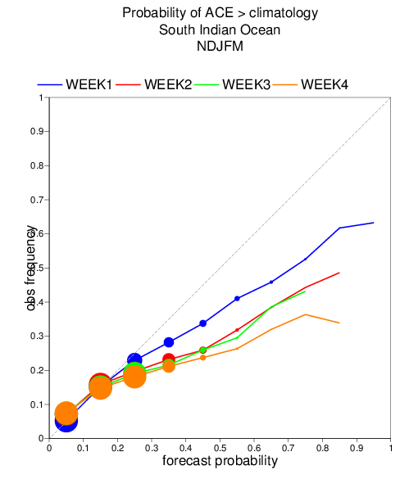
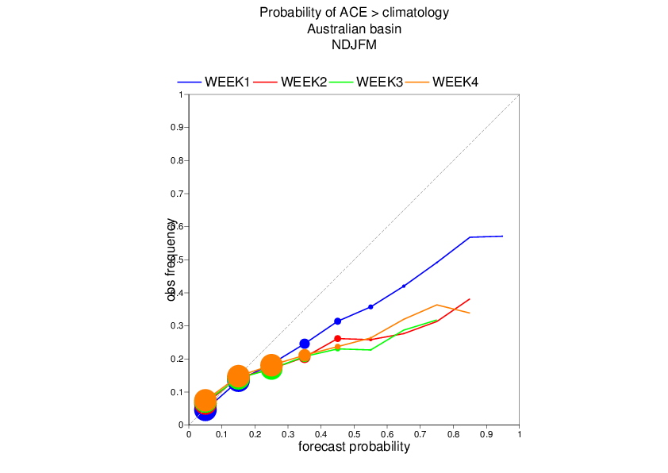
Reliability diagram
Probability of ACE anomaly (20x10 degree box) in upper tercile

